Slide 1

TRAFFIC LIGHT CONTROLLER
NNAMDI ELIJAH OBI
PATRICK NONKI
GEORGE IZUCHUKWU ENEKWA
ABDUL-AZEEZ OLANLOKUN

Slide 2
MOTIVATION AND CONCEPT
WHY ARE WE DOING…?
WHAT ARE WE DOING…?
HOW ARE WE DOING…?

Slide 3
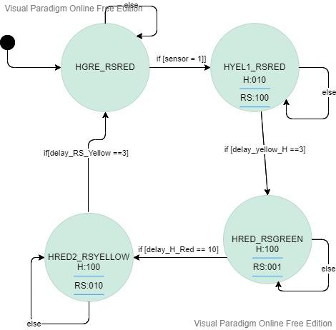
MODEL (FINITE STATE MACHINE)
Start state
Naming convention used
Triggers and guard conditions
Outputs in each state
Type of FSM model

Slide 4
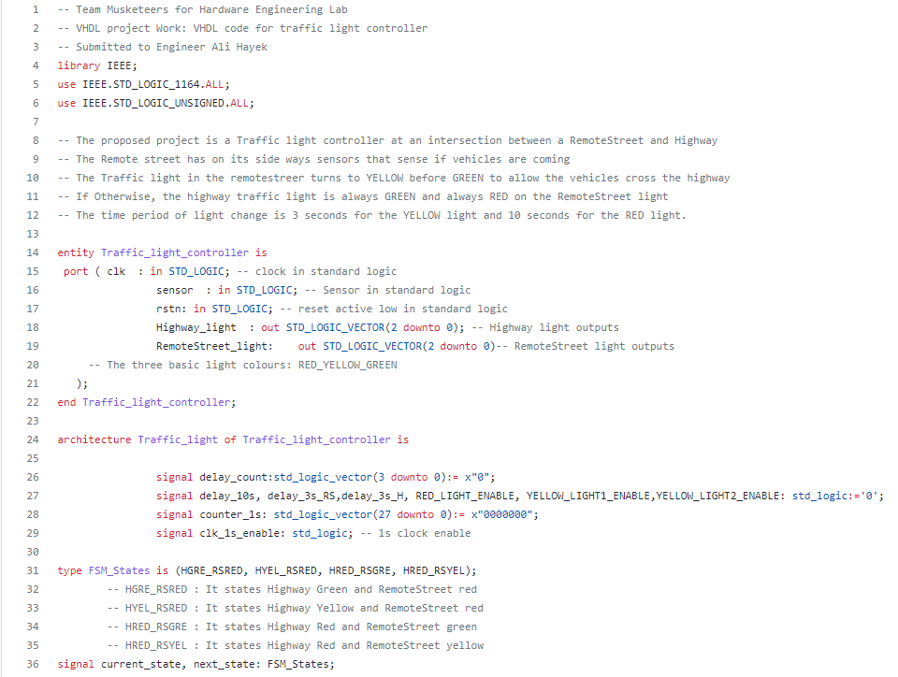
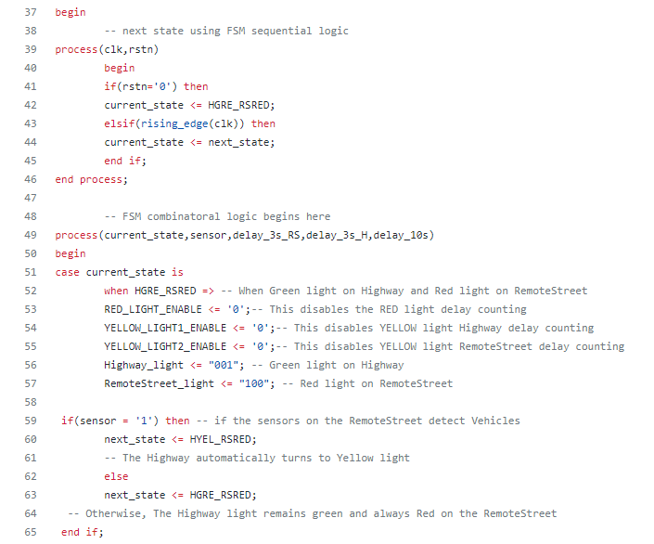
IMPLEMENTATION :VHDL CODE

Slide 5
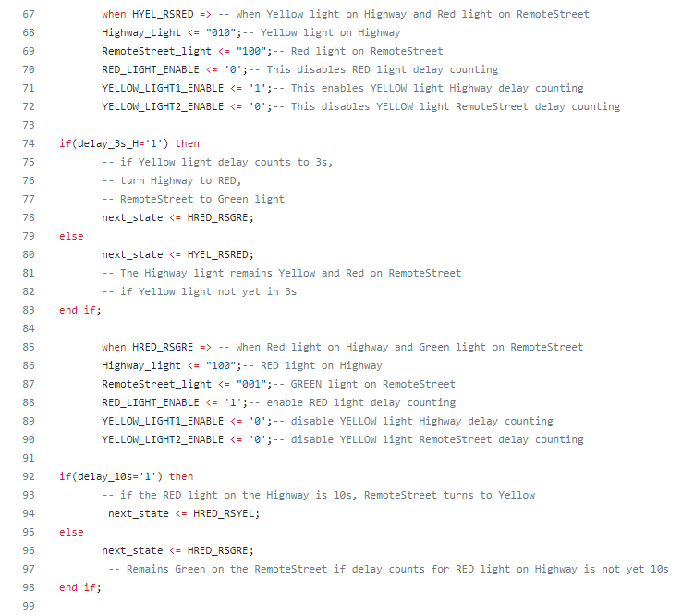
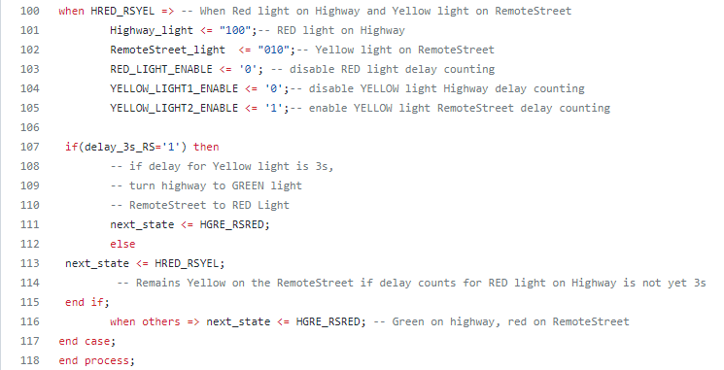
IMPLEMENTATION :VHDL CODE

Slide 6
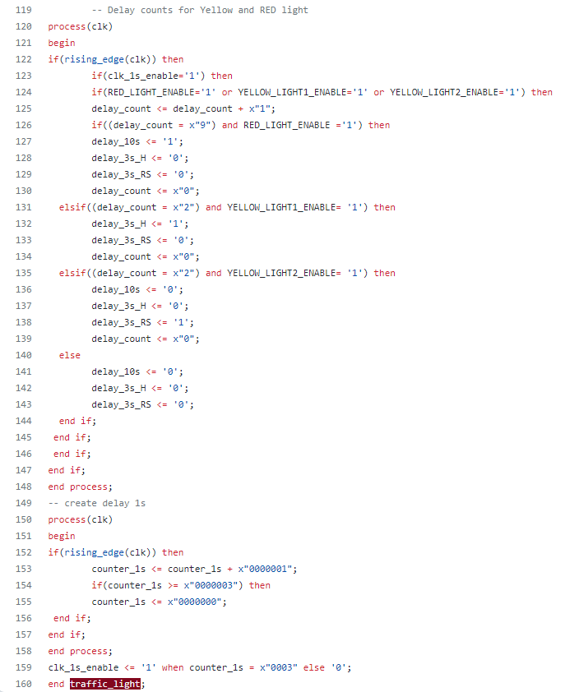
IMPLEMENTATION :VHDL CODE

Slide 7
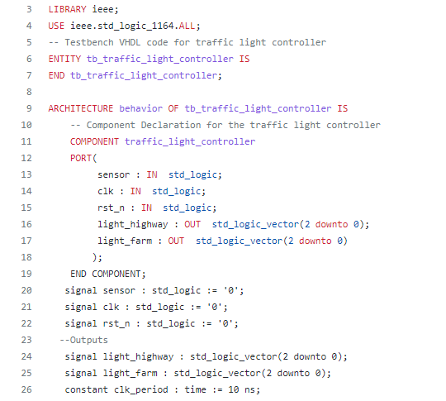
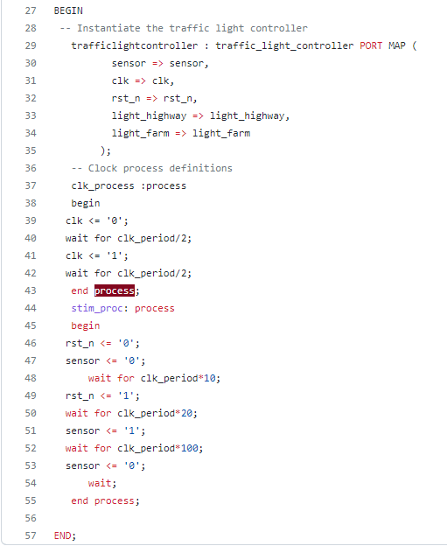
IMPLEMENTATION :Testbench VHDL CODE

Slide 8
CONCLUSION
WHAT WE’VE LEARNT THUS FAR…?
Thank you, any questions ?

